Slide 1

Data Visualization and Exploratory Data Analysis of Indian Premier League (2008 - 2020)

Slide 2
Our team
Anand Prakashbhai Shroff
0775235
Ravi Ravi
0795606
Santhosh Pachaiyappan
0788494
Simranjeet Kaur
0792193
Vignesh Dharuman
0801741

Slide 3





Agenda
01. Introduction
02. Match Analysis
03. Bowling Analysis
04. Feilding Analysis
05. Batting Analysis

Slide 4







Introduction
After India’s first world cup win in 2007 after 24 years, it was major tournament win for INDIA after a very long time. BCCI (Board of Cricket Control) took this opportunity as a golden chance to start a business of franchise based fast format cricket league which will be known as IPL (Indian Premier League) and the idea was similar to premier league of England and NBA of United states. The tournament has been a successful business venture and excellent instrument for cricket lovers from across the globe and have market value of US $6.3bil dollars in last 13 years which is an explosive growth.

Slide 5
Project Statement
Our team will be performing a descriptive data analysis of IPL matches played between 2008-2020 in order to gain meaningful insights and recognize patterns and relationships between various attributes.
The main points to cover in this project are as follows:
1. Comparing the home wins and away wins of multiple teams to visualize which team is stronger on the home ground and which one is stronger on the away ground, and which are all keeping up in both, these visualizations will help figure out the strong winning ratios of teams based upon the ground.
2. Comparing bowler vs batsman also helps to identify the winning probability of the match.
3. The players and the average runs they scored to predict the outcome of their performance in the upcoming game.
4. Predicting the future performance of Batsmen and Bowlers based on previous performances.

Slide 6
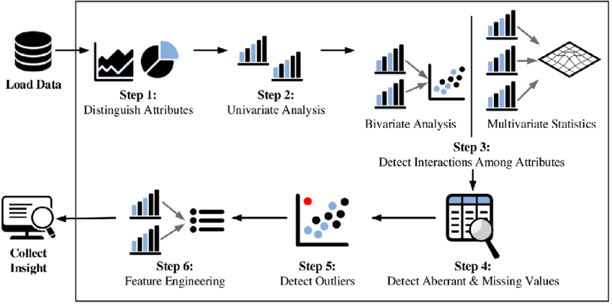
EXPLORATORY DATA ANALYSIS

Slide 7
MATCH ANALYSIS
Analysis on team winning percentage and toss decision and whether toss decision is important..

Slide 8
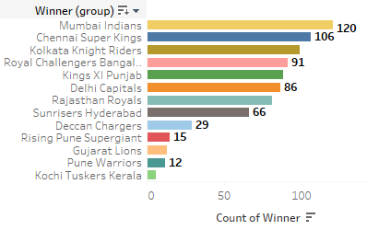
MATCH WINNERS
Total number of matches are 850 from 2008 to 2020
Mumbai Indian won the highest no of matches and Kochi Tuskers Kerala is the least
Mumbai Indians has the highest success rate

Slide 9
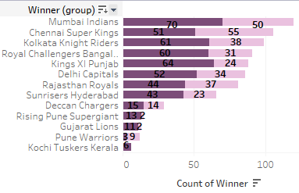
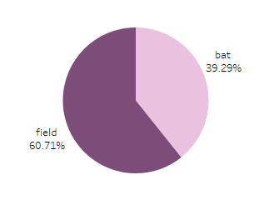
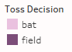
TOSS DECISION
On Analysing the data it clearly shows that Toss decision is the key to match winning.
Winning percentage based on toss decision clearly states that team who chose fielding has won more number of matches
But that is not applicable for all the team where Chennai Super kings won more matches on choosing batting

Slide 10
Conclusions after Match Analysis
Toss winning and toss decision is important in a match which literally predicts the 50% of match status.
Mumbai Indian and Chennai Super kings are the most successful team in the IPL history with highest number of match winnings and highest number of title winners
Based on the team toss decision is the major role for the match for eg , Mumbai Indian are good are chasing where Chennai Indian are good at defending.
Toss decision also matters based on pitch condition and weather condition as well.

Slide 11
BOWLING ANALYSIS
Analysis shows the number of analyses done on the bowlers and type of bowlers. With the help of this analysis, we are trying to find out who succeeds and what type of bowler would likely to perform.

Slide 12
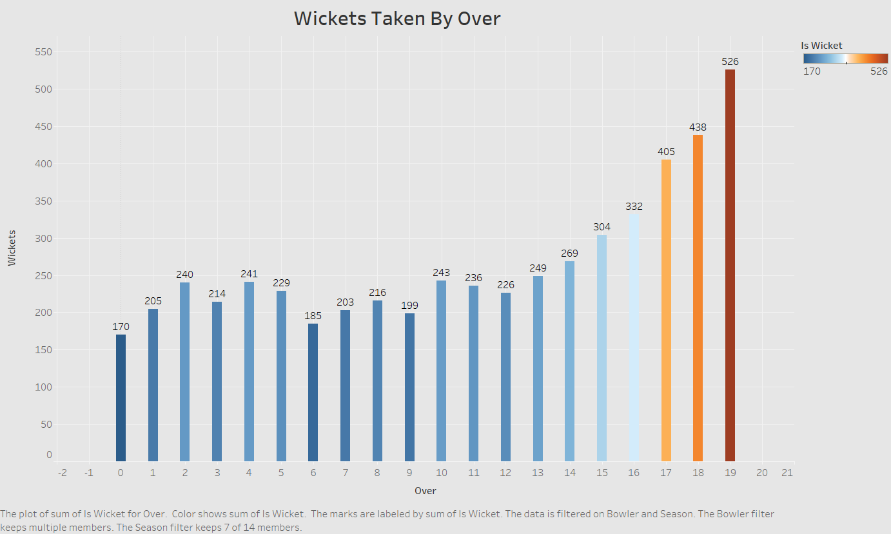
WICKET TAKEN BY OVER
Number of wickets taken by bowlers in overs, here 0 represents 20th which is last over of any innings(there are 2 innings in 1game) on top of that this chart also shows which one of the top bowlers in filtered season.
Who takes the most amount of wickets in that given overs and by looking at the dashboards it can be said that DJ bravo heavily outshines every other top bowlers in 19th over of the game with 25 wickets which is almost 90% of the total wickets in one season.

Slide 13
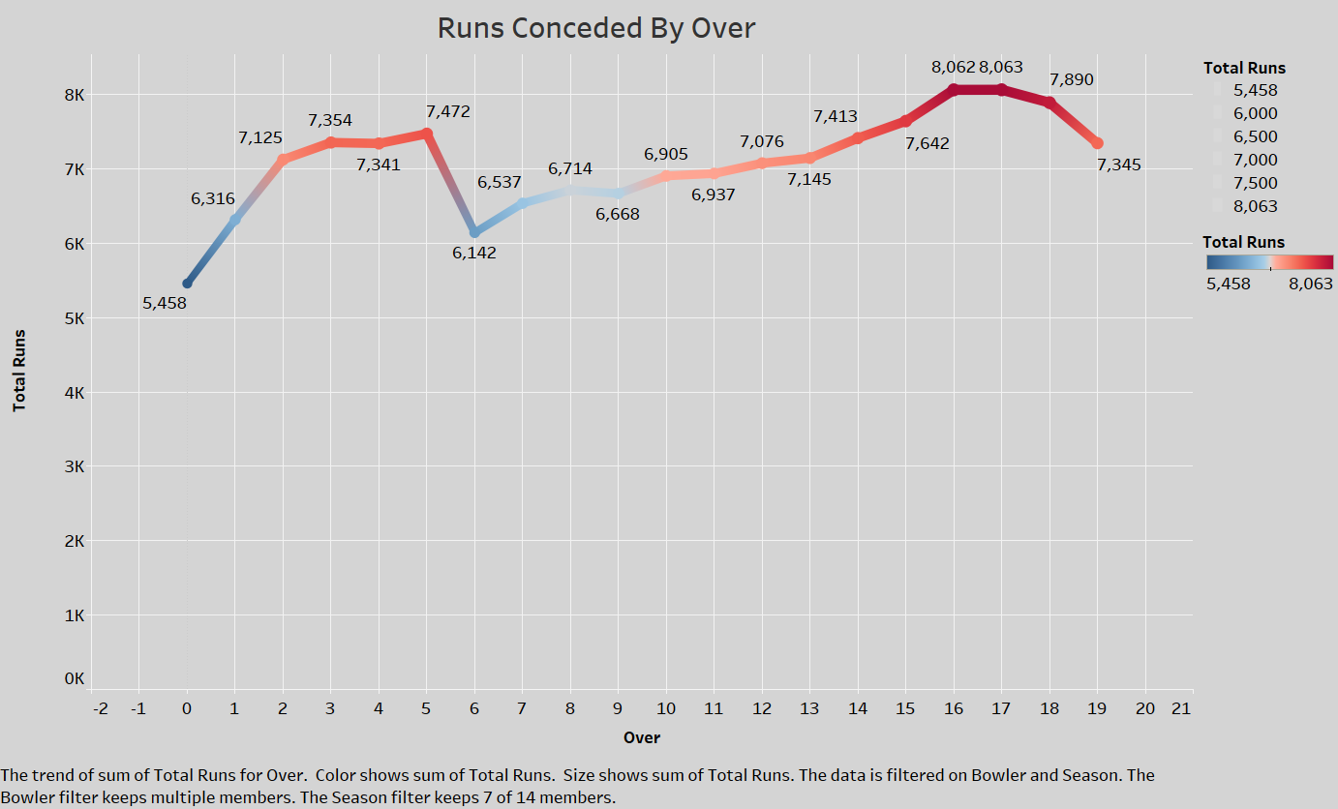
RUNS CONCEDED BY OVER
Runs distribution throughout the game by filtered season and this chart also depicts the bowlers who concede highest amount of runs in overs this chart helps to find out overs where most amount of runs comes from and also shows the flow of runs throughout a game.

Slide 14
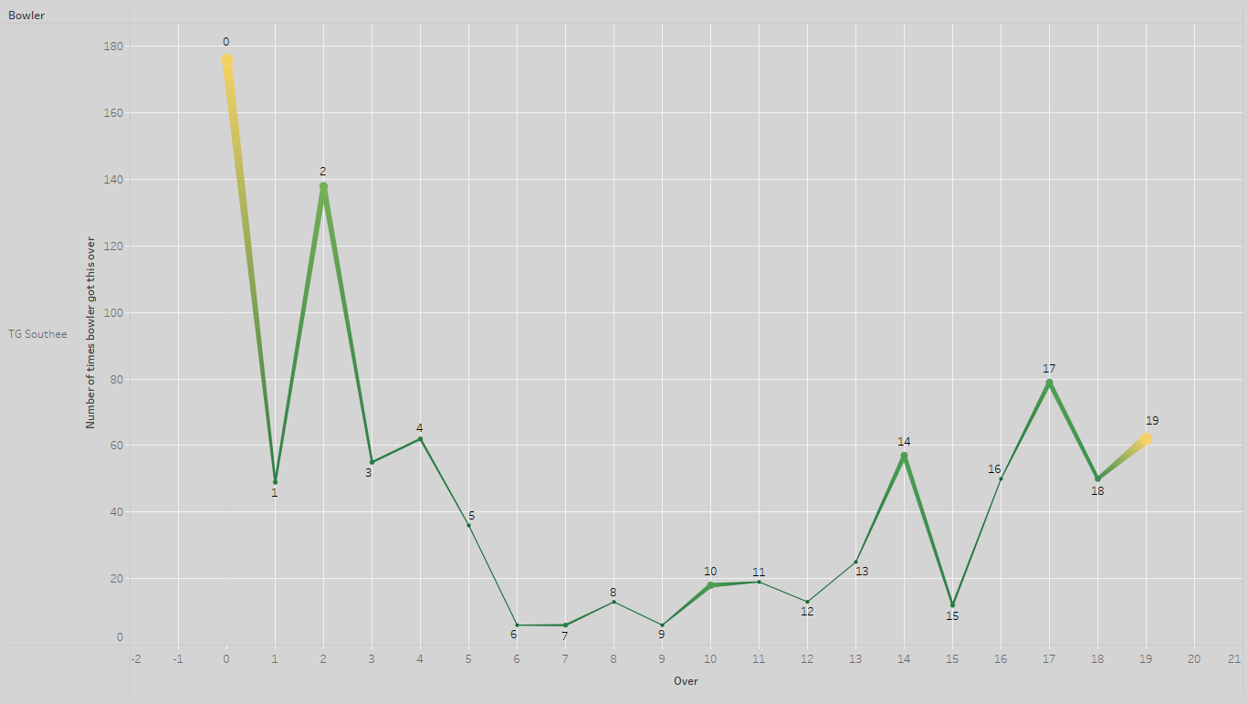
Data of Bowler
Data of bowler, number of overs he has thrown filter by season and bowler, user can see strength and weakness overs of any bowler and can find out where bowler finds most of his wickets here 0 means 20th over of the inning.
For e.g.: we can see bowling details of K RABADA who is top bowler of 2020 season and we can see during the season majority of his wickets come in 17th and 19th over thoe he hardly succeeds in 1st and 5th over who he has bowled 3rd highest time

Slide 15
Conclusions after Bowling Analysis
Having a lower Economic Rate or Higher number of wickets is good shows the competency of the bowler but best bowlers are the those who have lower economy rates with high amount of wicket for E.g.: Piyush Chawla has 2nd most wicket taking bowler also high in conceding runs which makes him decent bowler but R. Ashwin has highest runs conceded but not in Top 5 list of wicket taking bowlers shows poor form.
In Wickets and Runs conceded not only affects the bowlers but also to the team it can be seen in graphs that whenever the number of runs go down the number of wickets is high. In 17th,18th,19th which also shows in the final phases of the game the batting team plays more aggressively and careless about wickets and batting teams are more cautious in 5th and 6th overs.
Highest wicket taking bowlers often get to take wickets in the last overs, where batsman plays more recklessly.
This analysis has also shown us run conceding pattens throughout 13 yr and also helped us finding key skill points about the bowlers.

Slide 16
FEILDING ANALYSIS
This analysis involves taking a clear look into the fielding side of the data.
Which involves number of wickets taken by the fielders and the different kinds of ways which occurred.
The main data which are used to make this analysis is Dismissal Kind, Fielders and Overs.
The major areas which are focused on the analysis are Caught-out, Run-out and Stumping.

Slide 17
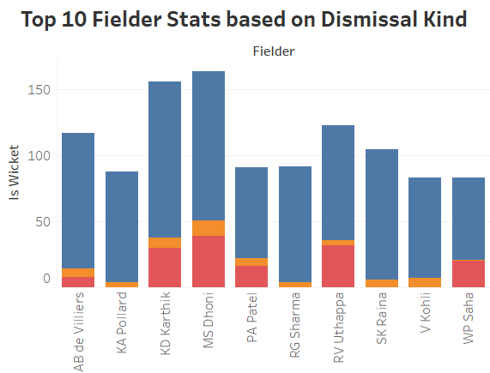
TOP 10 FIELDER STATS
Fielders are plotted in y-axis and the number of wickets are plotted in x-axis.
The wickets are categorised based on dismissal kind.
Major contributors of dismissal kind are Caught out, Run out and Stumped.
The player with most wickets in all seasons is MS DHONI.

Slide 18
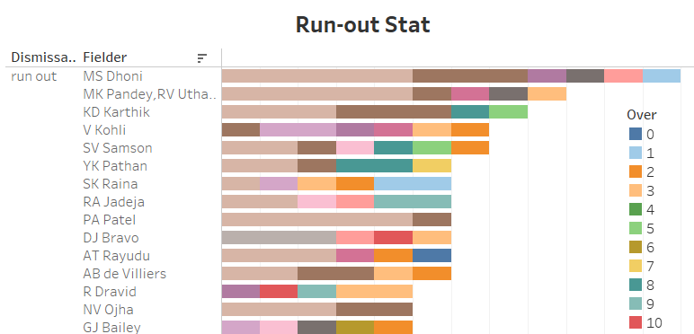
RUN-OUT STAT
Categorized with the run outs occurred over number of seasons.
And this gives us insight into most occurred runouts over the particular overs.
The player with the greatest number of run outs in all seasons is MS DHONI

Slide 19
Conclusions after Feilding Analysis
The major outcomes out of this particular analysis involves figuring out the strengths of the fielders on ground.
This analysis provided stats on different types of dismissal kinds and which fielders are better at it, which in turn could help out the owners of the teams during the players auction to help them bid on a player who excels at fielding.
This analysis also helps bowlers and batsmen understand at which overs they should be concerned about which kind wickets they can take or avoid respectively.

Slide 20
BATTING ANALYSIS
To analyse and explore the data concerning batting to get important insights such as:
To find top batsmen in the league.
To analyse the factors affecting batsman’s performance.
To evaluate player’s performance in different conditions.
To explore performance of teams.

Slide 21
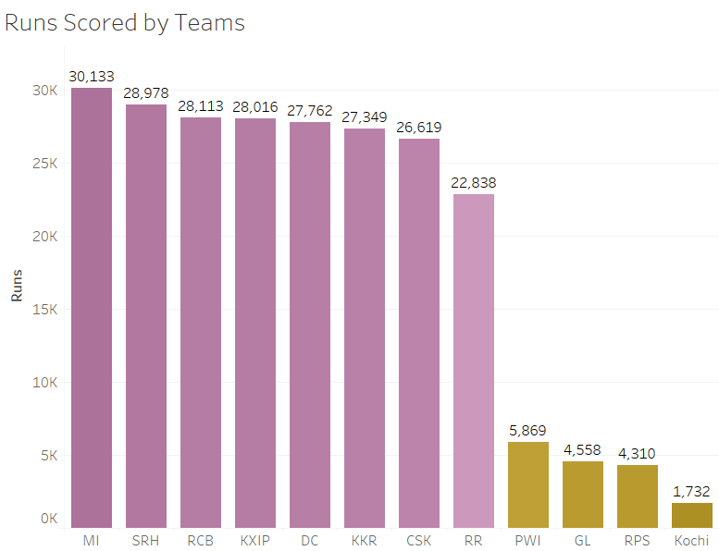
Total Runs Scored by Teams
Teams are mentioned along the x-axis and sorted in descending order based on total runs, where runs are depicted along the x-axis
The plot provides insight on how each team has performed in terms of batting.
While the plot displays information regarding all the seasons, any particular season can also be selected from drop down menu for thorough analysis of team’s performance.

Slide 22
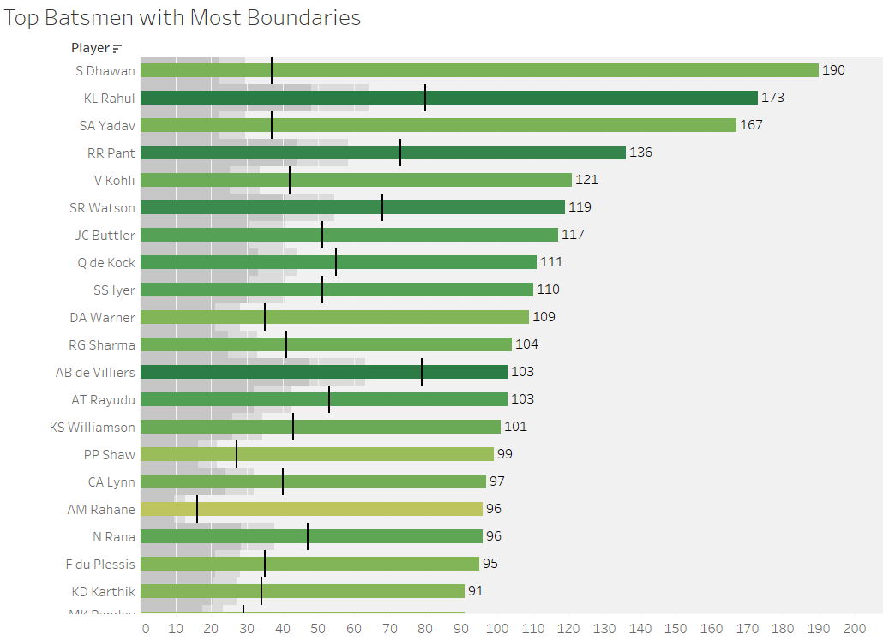
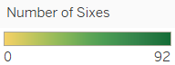
Top Batsmen based on Number of Boundaries
Details of batsmen with highest number of boundaries (4’s and 6’s).
Order of batsmen is sorted according to number of 4’s hit i.e. from highest to lowest.
Total number of 4’s are mentioned at the end of bar and total number of 6s are depicted by a black vertical line on each bar and colour range.
This charts provides insight on the batting style of a batsmen.
For example, it is evident that Shikhar Dhawan mostly goes for 4’s than 6’s as he has hit maximum 4’s (190) but only 37 sixes, while KL Rahul has more balanced approach with 173 four’s and 80 sixes.

Slide 23
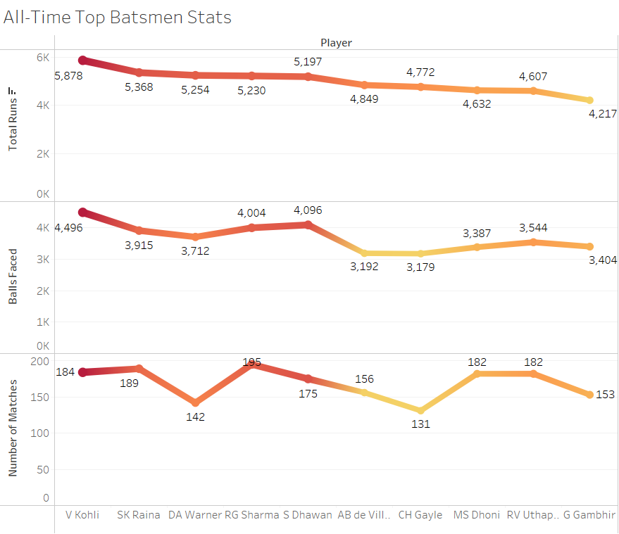
All-Time Top Batsmen’s Stats
Details of all time top scoring batsmen from 2008 till 2020.
Players are mentioned on the x-axis and are sorted in descending order based on highest ‘Total Runs’ scored.
‘Balls Faced’ and ‘Number of Matches’ fields are placed on y-axis, which adds on to the stats for respective players.
Virat Kohli is the highest scoring batsman with 5,878 runs and has faced highest number of balls (4,496) and comes at 3rd place in terms of total matches (184).
One interesting insight is David Warner scoring 3rd highest total runs while playing only 142 matches

Slide 24
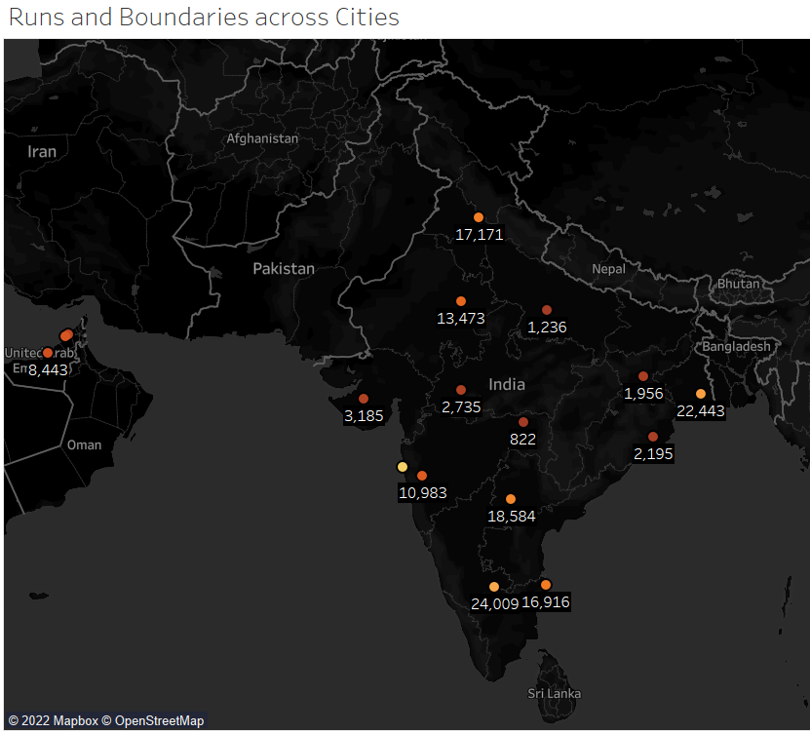
Runs and Boundaries Scored across Cities
The map provides details about runs and boundaries scored in various cities.
The coloured dots represent different cities based on total runs scored there.
Selecting any dot will show details such as city, country, runs scored, 4s and 6s hit.
It also provides information about number of matches played at that venue.
From the map, it is clear that maximum runs (30,244) were scored in Mumbai followed by Bangalore with 24,000 runs.
This map gives a basic understanding of which venues have been high scoring venues.

Slide 25
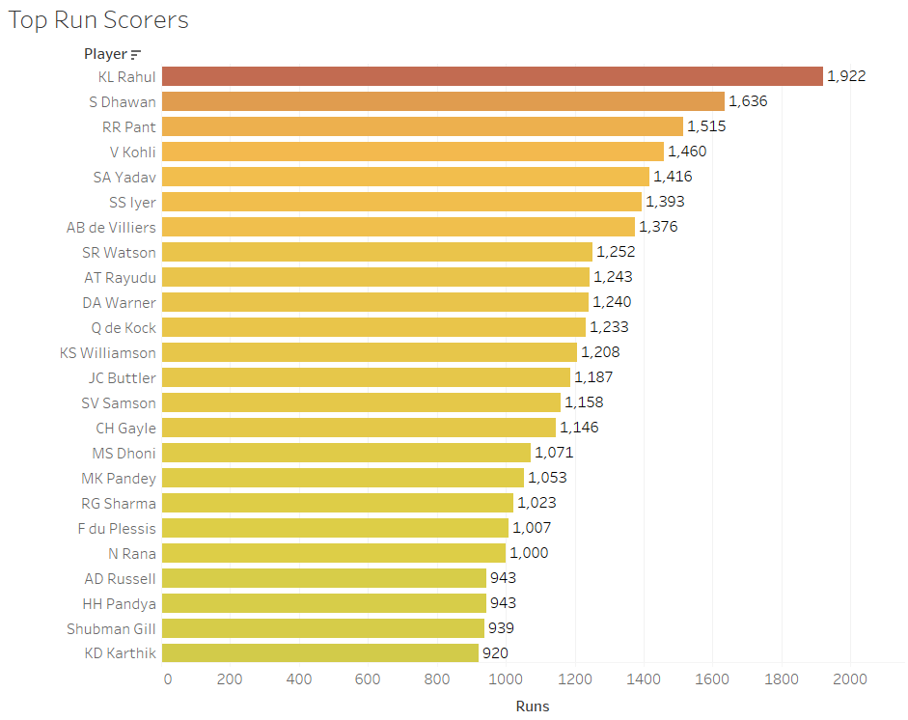
TOP RUN SCORERS
Players are sorted in descending order based on runs scored in a particular season or group of seasons. Season can be selected from drop down menu.
It’s helpful in getting insight on recent performance and form of a batsman.
It is useful in comparing previous and current performance of a player.
In this chart, Top run scorers from latest three seasons (2018,2019 and 2020) are displayed, which shows that KL Rahul is currently the most successful batsman in IPL with 1,922 runs.

Slide 26
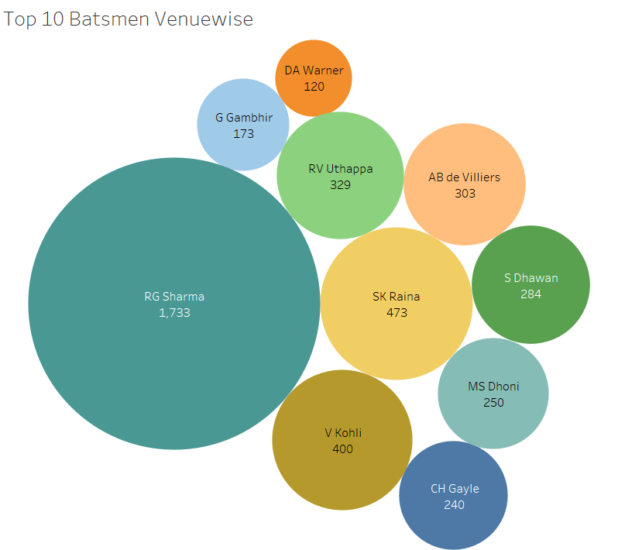
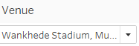
Top 10 Batsmen Based on Venues
The visualization displays top 10 highest scoring batsmen on various venues.
Batsman’s name and runs scored are shown in circles. The size of circle depends on the rank of the player in terms of runs scored.
A drop down menu provided at the top left corner can be used to select different venues.
In this graph, venue selected is Wankhede Stadium, Mumbai where RG Sharma has scored highest runs 1,733.
Top 10 batsmen vary from venue to venue.

Slide 27
Conclusions after Batting Analysis
Virat Kohli is the highest run scorer with 5,878 runs in 184 matches. While David Warner has played second least number of matches (142), he is still 3rd highest run scorer. It can be deduced that David Warner records high runs in each game in comparison to others and is a highly bankable player to expect high scoring games when he’s playing.
Some of the players have retired or haven’t been able to score in recent years. Keeping the future prospects in mind, data can analysed to obtain information of current top batsmen by selecting recent seasons. From our analysis, KL Rahul is the top emerging batsman since last 3 seasons with 1,922 runs.
For different venues, there are different high run scorers e.g. RG Sharma has scored 1,733 runs in Wankhede Stadium, Mumbai and G Gambhir has scored 1,407 runs in Eden Garden, Kolkata. That is mostly because of the reason that these venues are their home grounds. This means they have experience at those venues and are ought to perform well when matches are at these venues.
As a team who has played all the seasons from 2008-2020, Mumbai (MI) is the highest scoring team with 30,133 runs, while Rajasthan (RR) has scored the least runs 22,838 runs.

Slide 28
CONCLUSION
The three main results from the analysis are as follows:
Methods developed:
In this a detailed summary of the methods used, how they are chosen to do a specific task and how they are used to get best result out of the datasets will be provided. Insight will be provided on how methods are used to know about relation between csv sheets, tableau, and visualization with help of data analysis.
2. Model to predict:
Project will deliver the various ways to correlate variables of data and will provide a great overview of data. Our team will also provide different charts in form of visualization to understand analysis easily for future reference.
3.Analysis of data:
this project will provide a well-managed dashboard on tableau with reference to other documents and material used to carry out this project. our team will provide a detailed narrative summary of each step of project.
Analysis on Batting, Fielding and Bowling with different aspects will provide detailed information about various variables.

Slide 29

Thank you

